Slide 1



Careers in Health and Science Exposition
Information for attendees

Slide 2
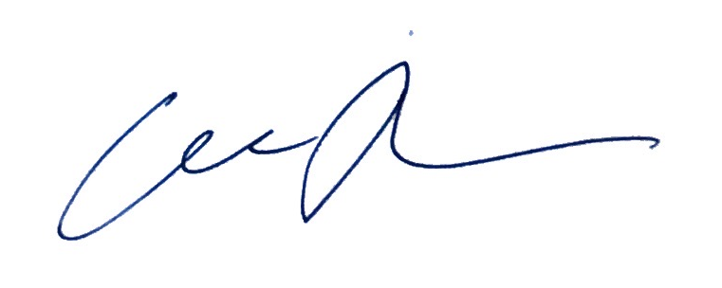

WELCOME TO CHaSE 2020!
9,000 of the most talented students and researchers in Sweden, study and work at Karolinska Institutet.
Over 2,500 of them are looking every year to begin a new, exciting stage in life.
It is my pleasure to invite you to CHaSE 2020, Stockholm’s premier career and jobs fair in life sciences and health.
Since 2014, CHaSE has put more than 75 organizations in touch with students from top Swedish institutions, (e.g. KI, KTH, SU, UU, LU etc.) counting 6000 bachelors & masters students, 2100 PhD students and 900 postdoctoral scientists.
Many LifeScience, Pharma and Biotech companies are looking for YOU as the talents of the future!
CHaSE helps you to network, reach out and interact with those companies. Moreover, we are here to assist you in your career planning. Looking for input on your LinkedIn profile? Is you CV up to date? What is the secret to efficient networking?
All this and more we plan to answer at CHaSE 2020. The day will be structured with company exhibitions, company presentations and workshops designed to maximize the potential of your career portfolio.
We look very forward seeing you at this all-online event! Stay tuned on our social media channels for all updates and sneak peaks on the event!
Please remember to register before-hand!
I warmly welcome you to CHaSE 2020!
Iida Tynkkynen
Project leader, CHaSE 2020

Slide 3
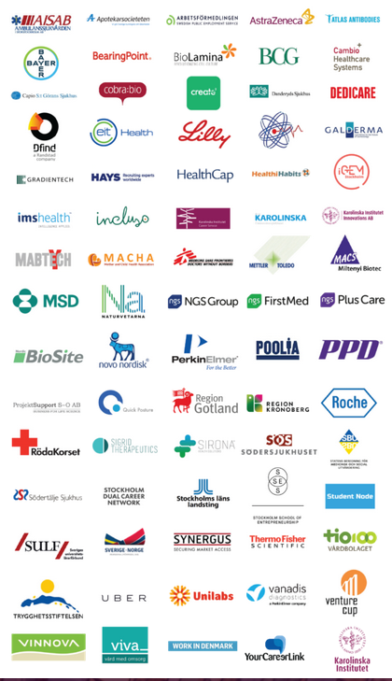
Participating companies and organizations (previously)

Slide 4
Date
Location
23rd November 2020 (Monday)
Virtual Conference
Event registration opens 23rd of October
CHaSE 2020 Details

Slide 5



Explore CHaSE online at http://chasesthlm.se/
Message us on any social media account, and at info@chasesthlm.se
@chasesthlm
@chasesthlm
@chase-stockholm
Contact

Slide 6
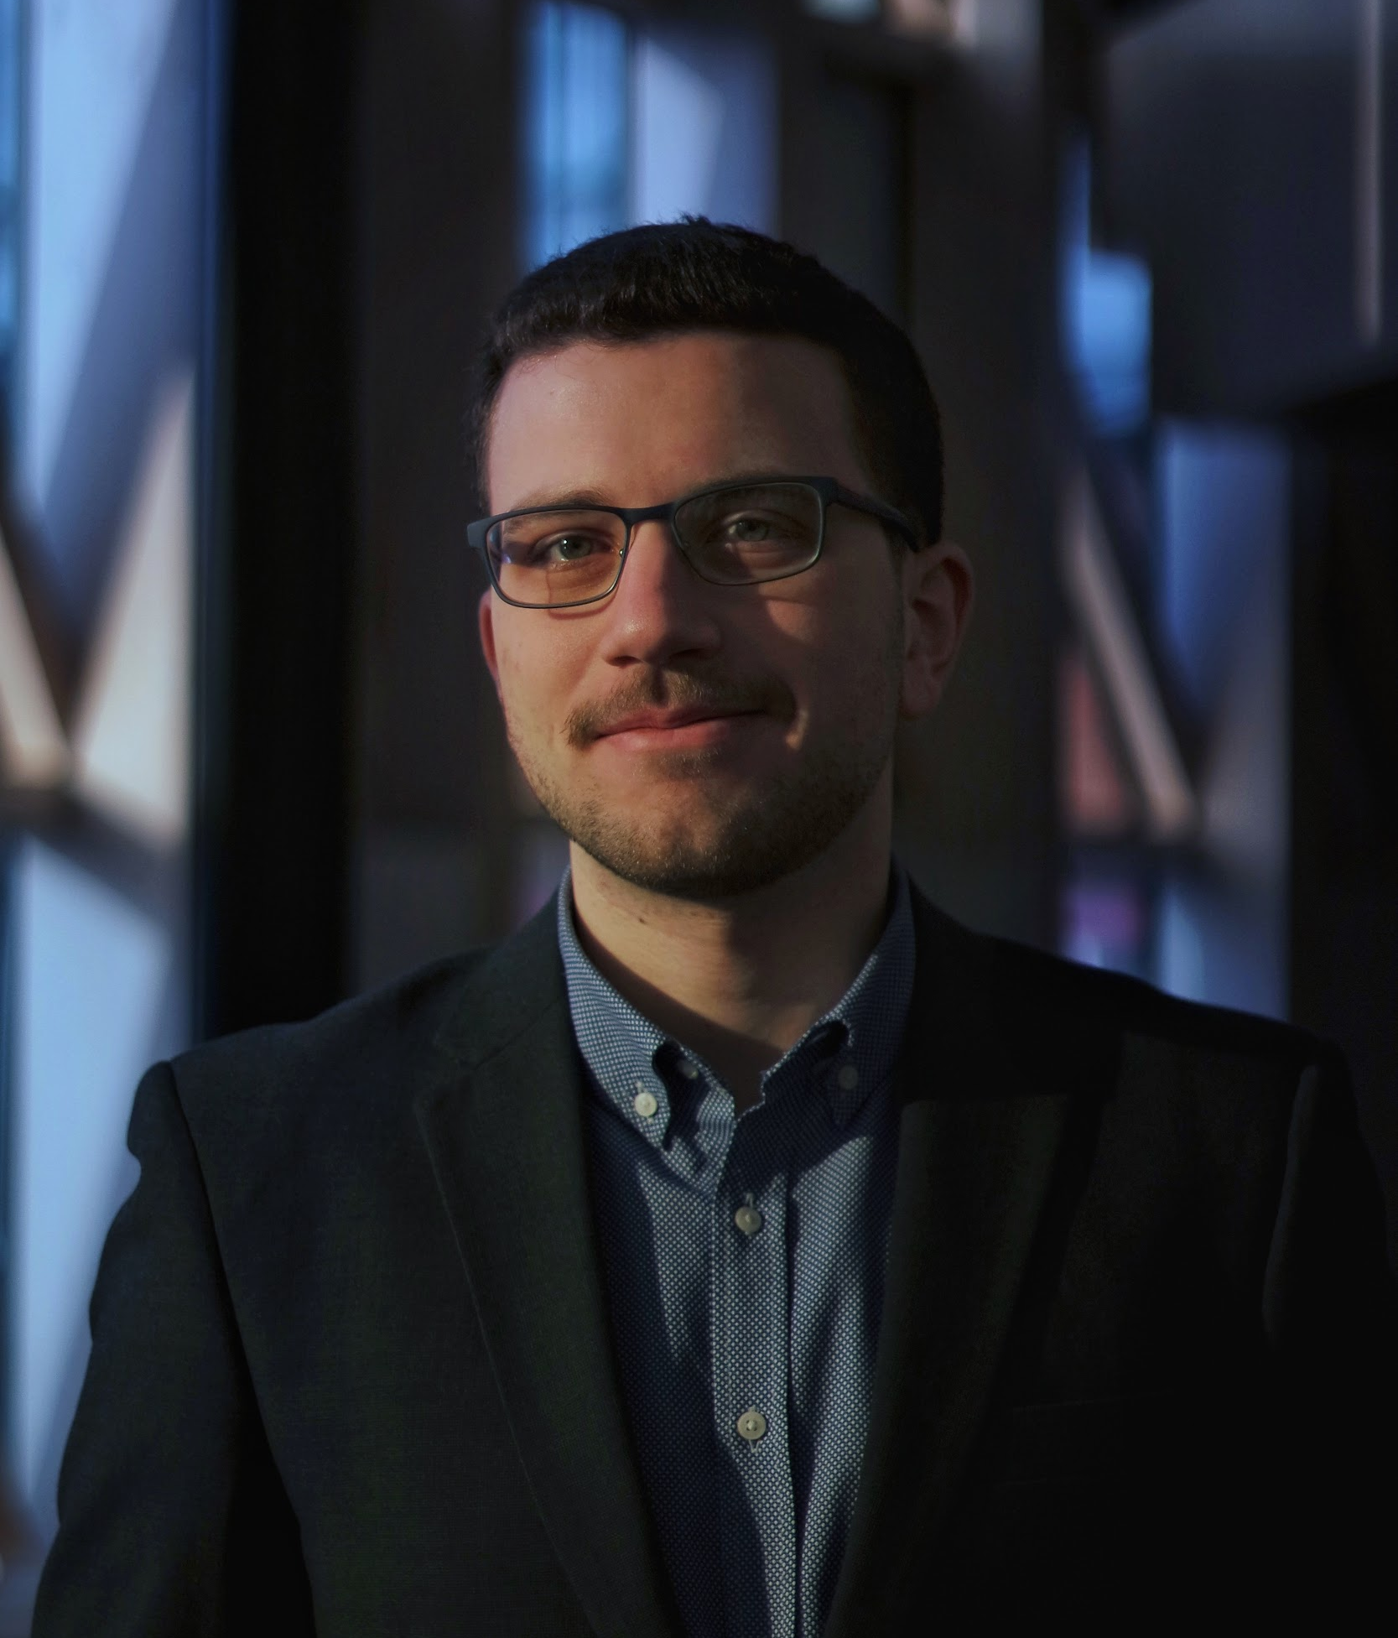
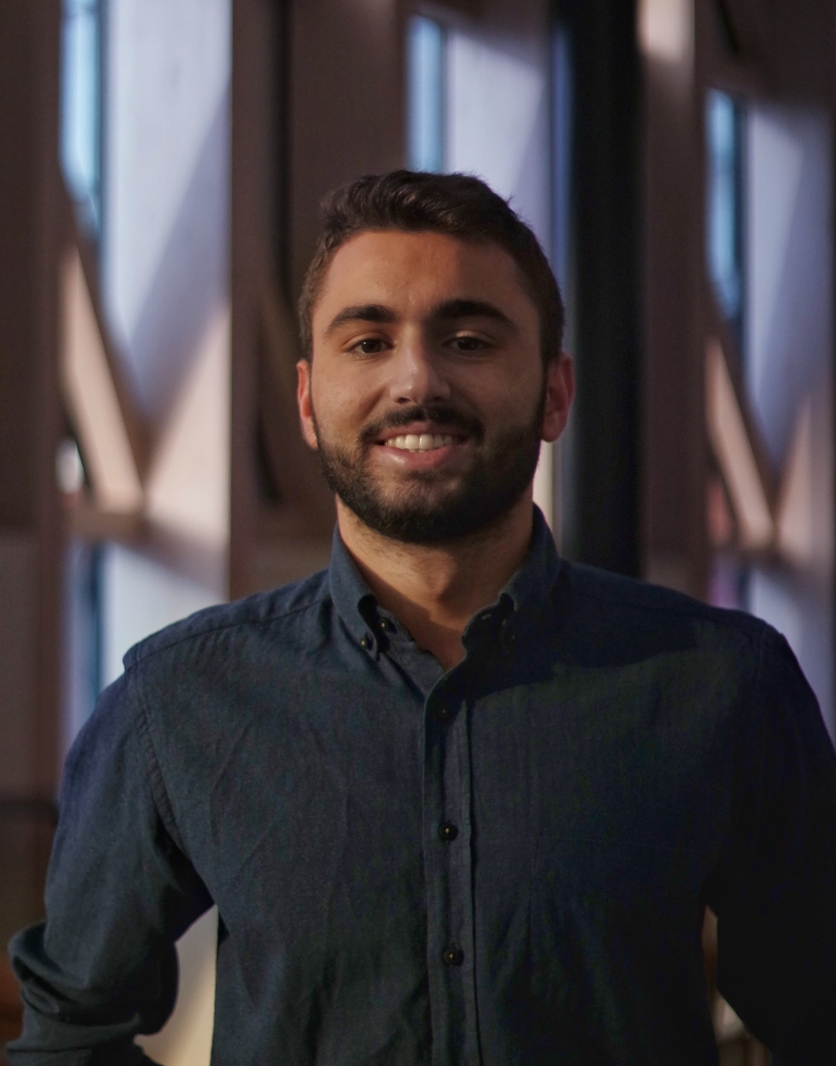
ORGANIZING BOARD
Efthymios Skoufas
Corporate relations manager
MSc. Medical Management (expected)
BSc. Pharmacy
-Co-founder, Finance & Sponsorships Director of the Pan-Hellenic Pharmacy Students Conference
-Instructor at the Benjamin Franklin Transatlantic Fellowship, a U.S. State Department exchange program.
Nikolaos Tagaras
Corporate relations manager
MSc. Toxicology (expected)
BSc. Biology
-Worked as a research intern on a project focusing on genome reprogramming after viral infection
-Biology teacher in a vocational training centre and a Technical Institute in rural Kenya for 2 months

Slide 7
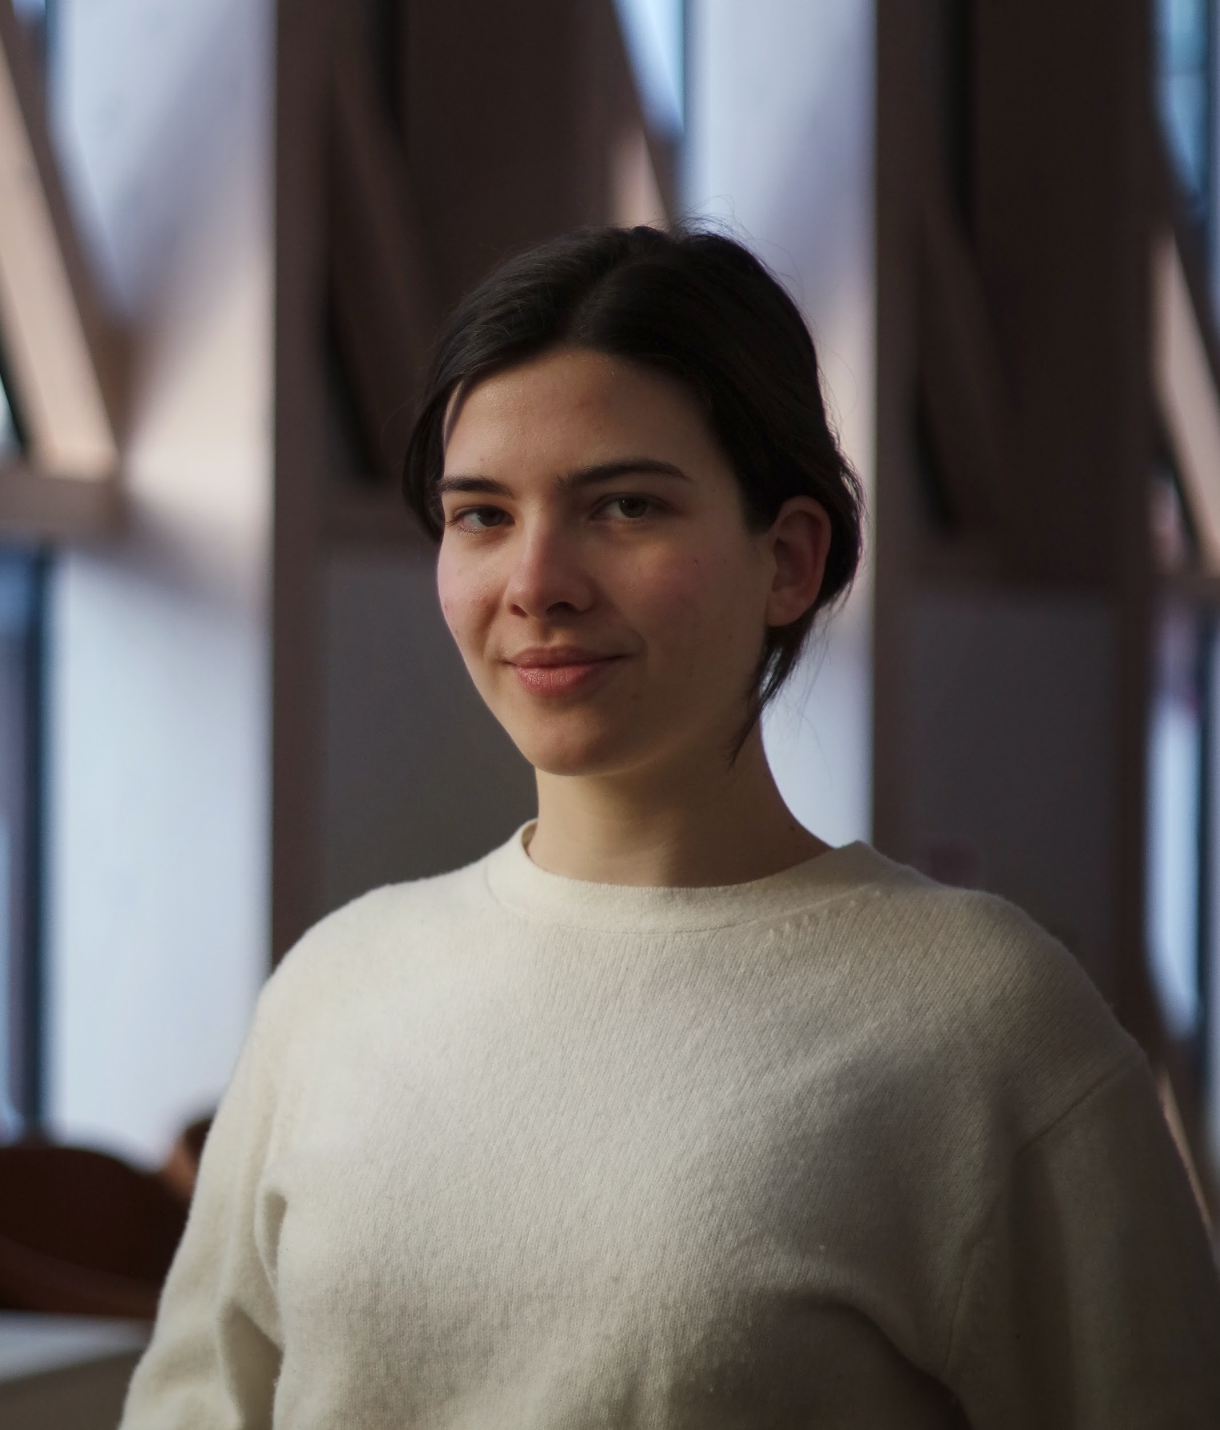
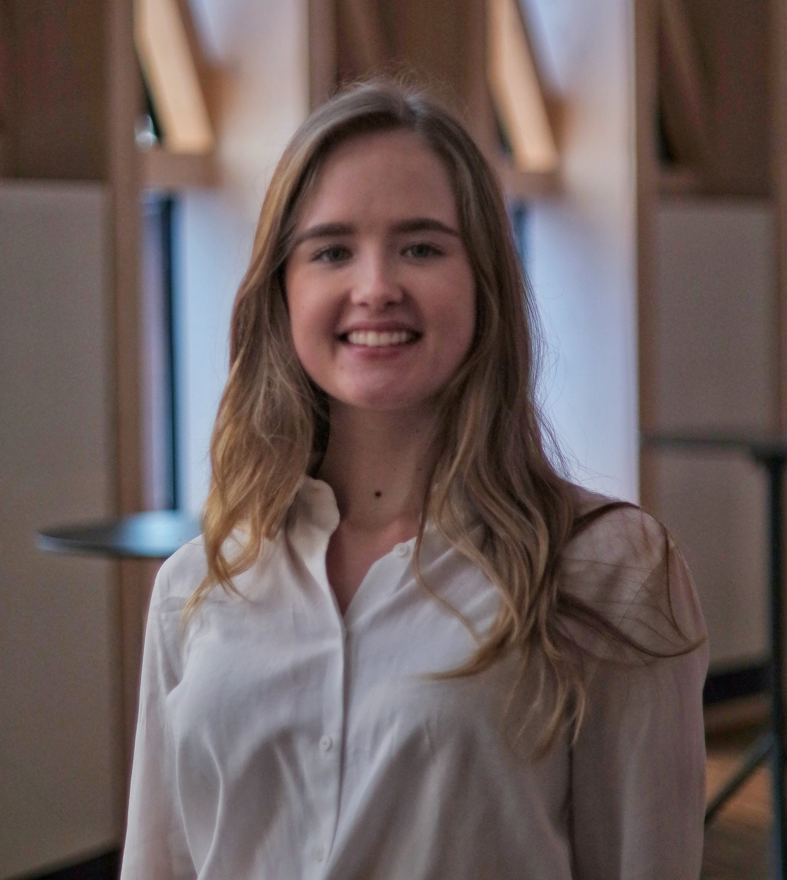
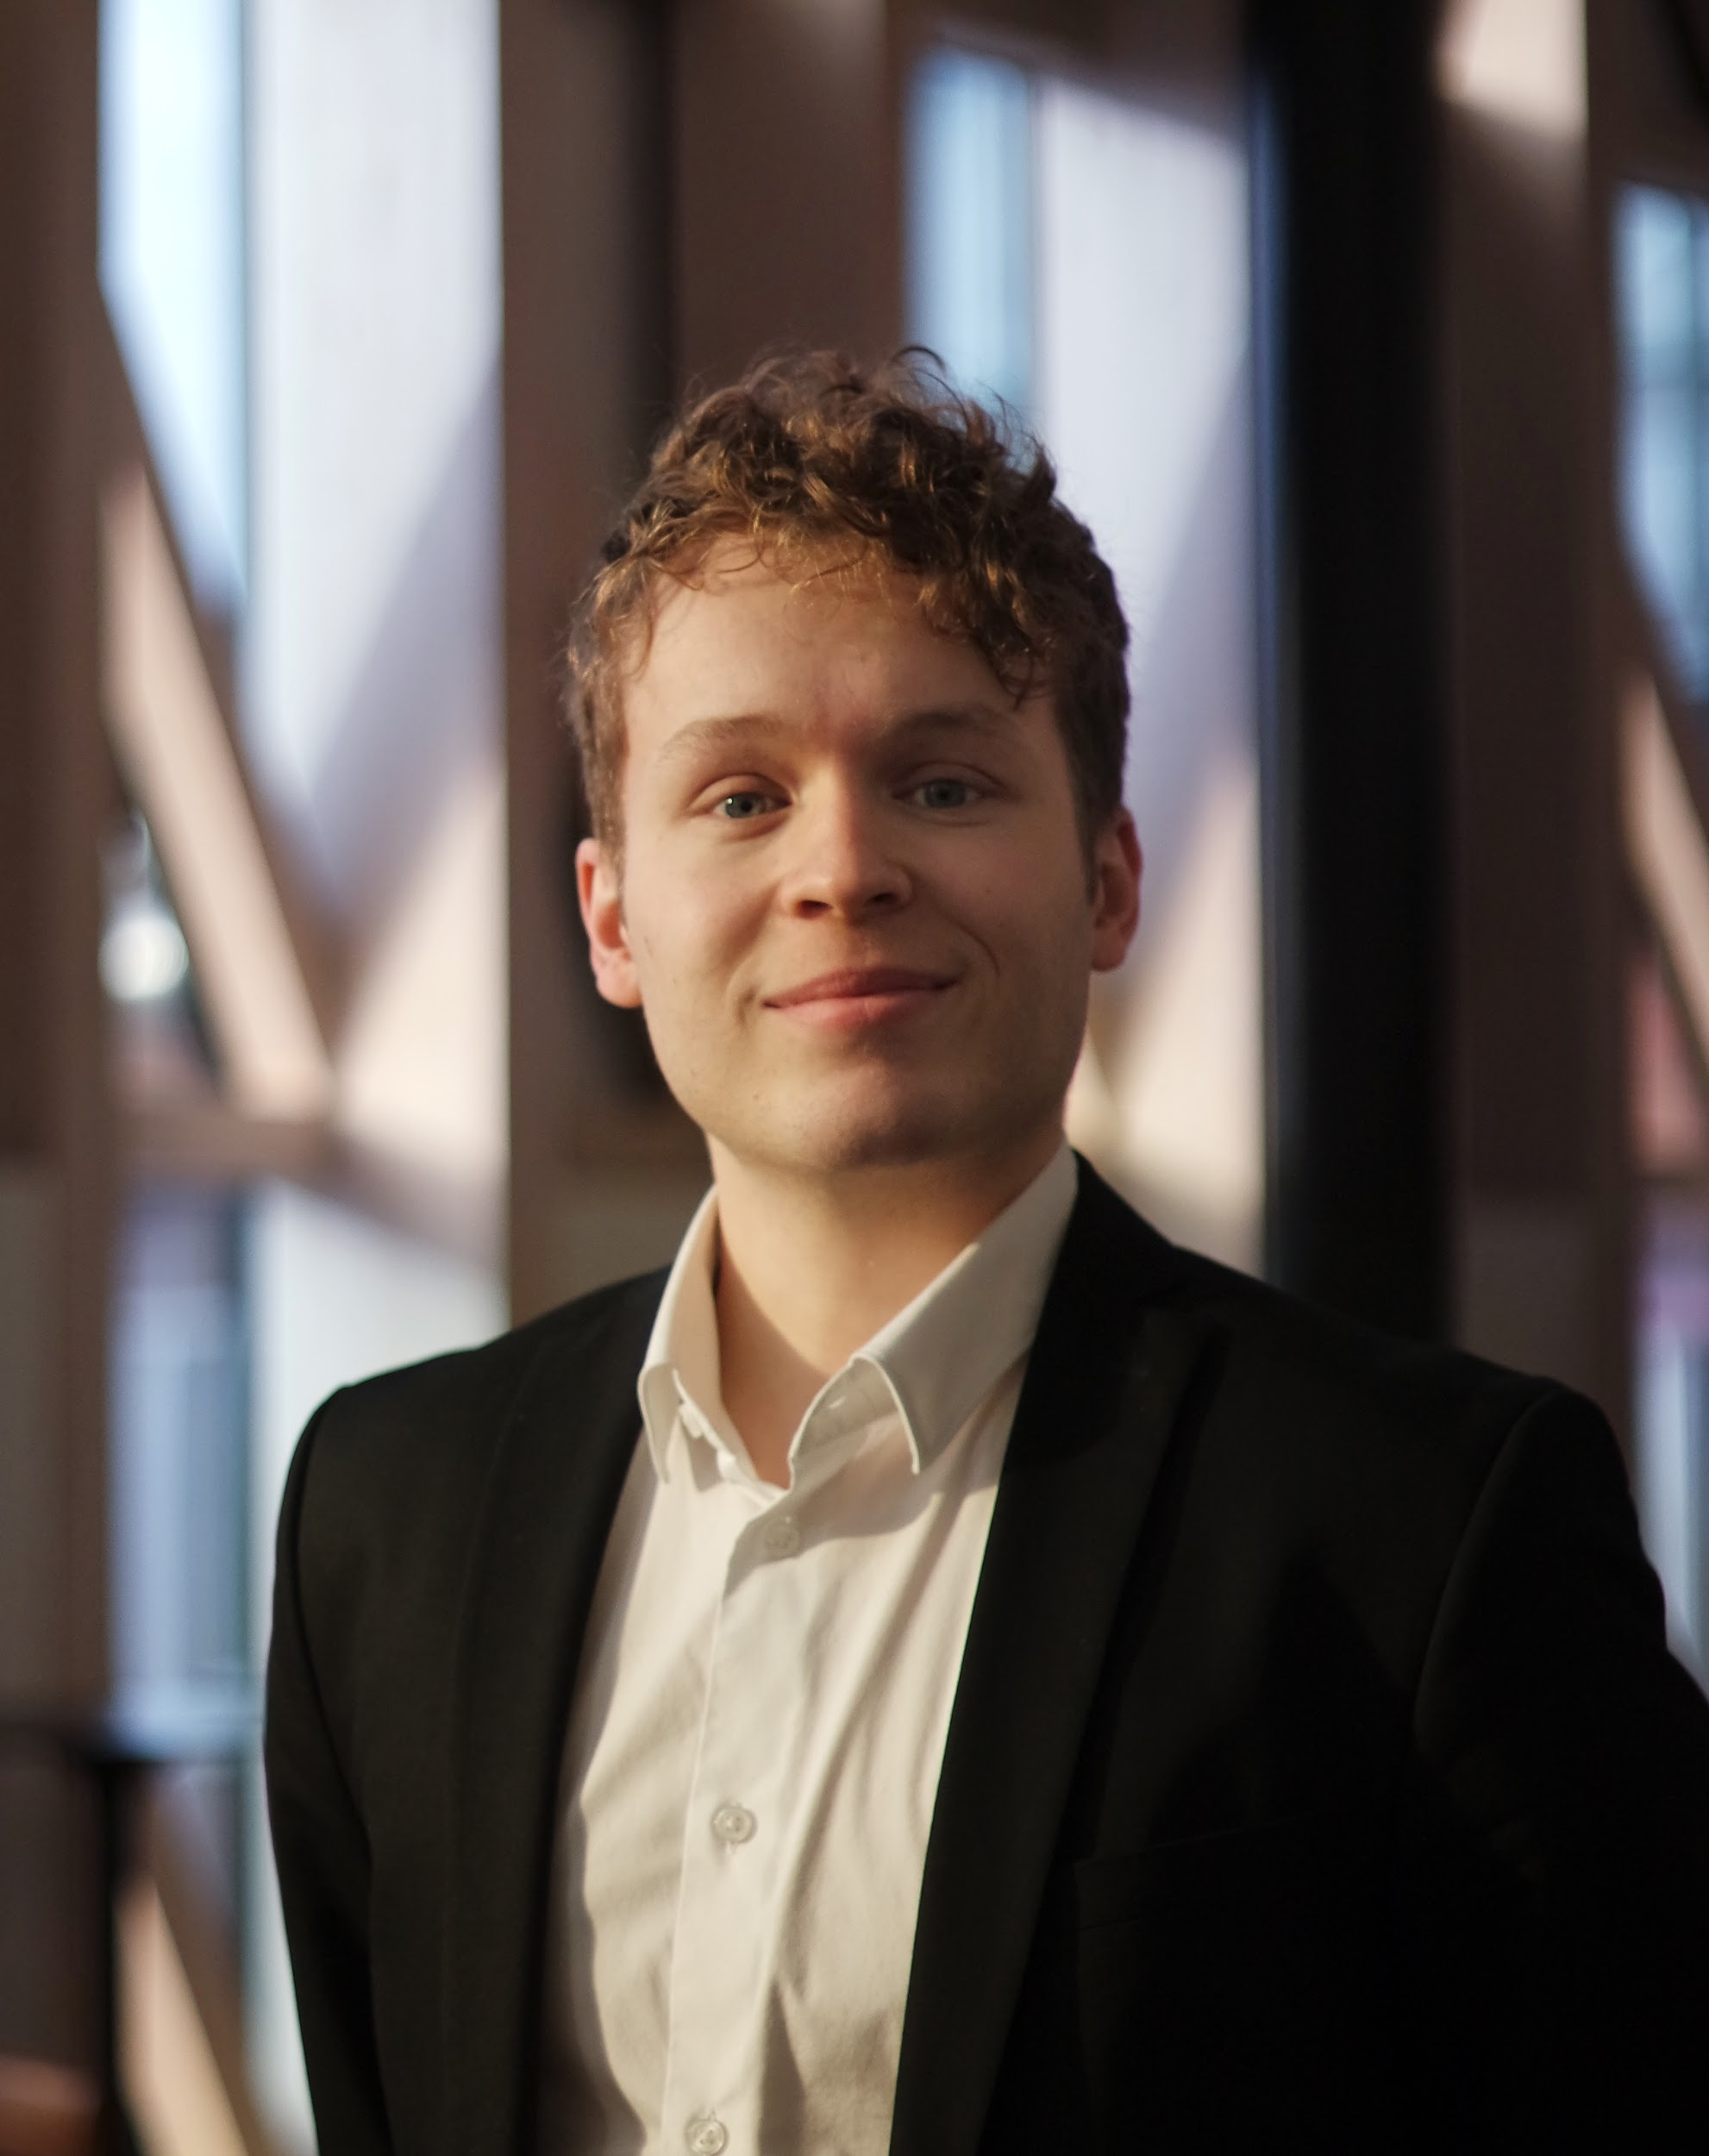
ORGANIZING BOARD
Maria del Pilar (Pili) Vidaurre Teixidó
Secretary
MSc. in Medical Management (expected)
BSc. in Biomedical Sciences
-Worked as a research intern in the field of cellular biology in International Institute of Molecular and Cell Biology in Warsaw and Bellvitge Biomedical Research Institute
-Hostess in several congresses
Iida Tynkkynen
Project leader
MSc. in Medical Management (expected)
BSc. in Public Health
-Conducted a report of the European Working Group of People with Dementia (EWGPWD) -model implemented in Finland
-Worked as a research assistant in Jyväskylä Centre
Rafael Rodrigo Escalera
Finance manager
MSc. in Medical Management (expected)
BSc. in Business Administration
-Worked at internal sales and operation in engineer manufacturing company
-Currently a treasurer of the Swedish association for international affairs

Slide 8
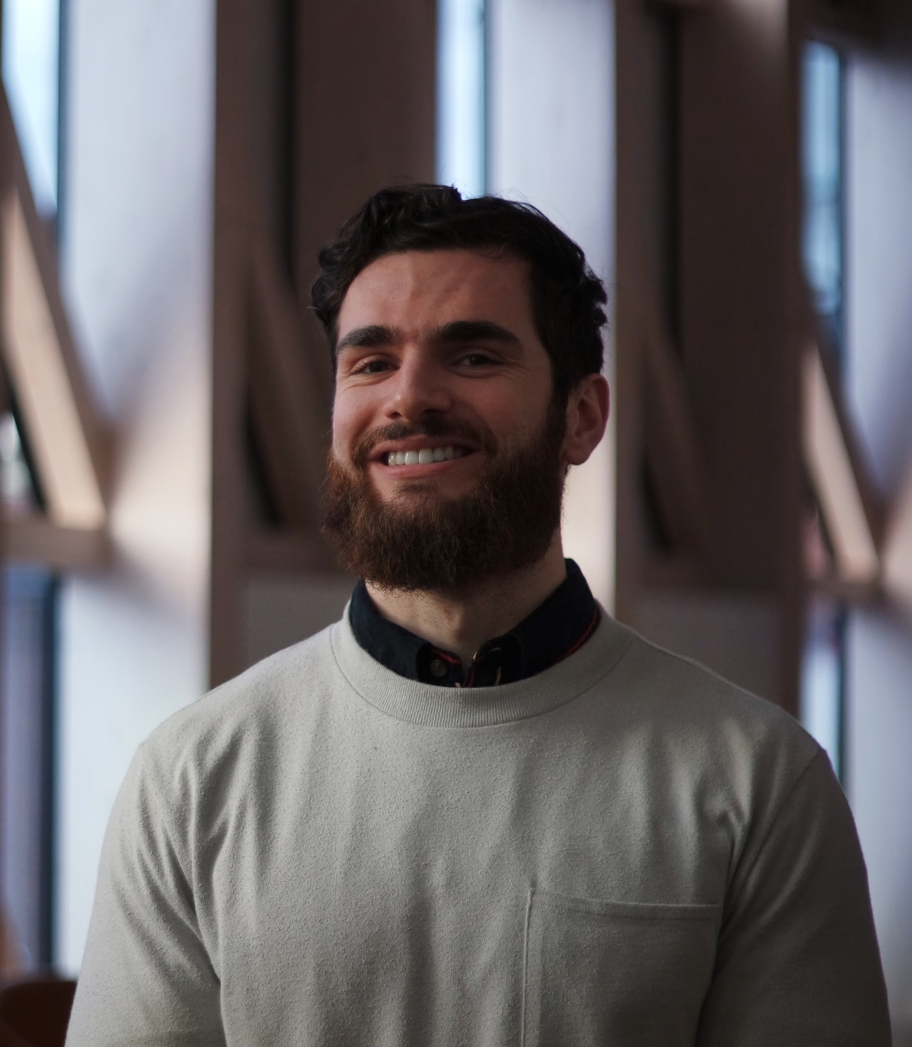
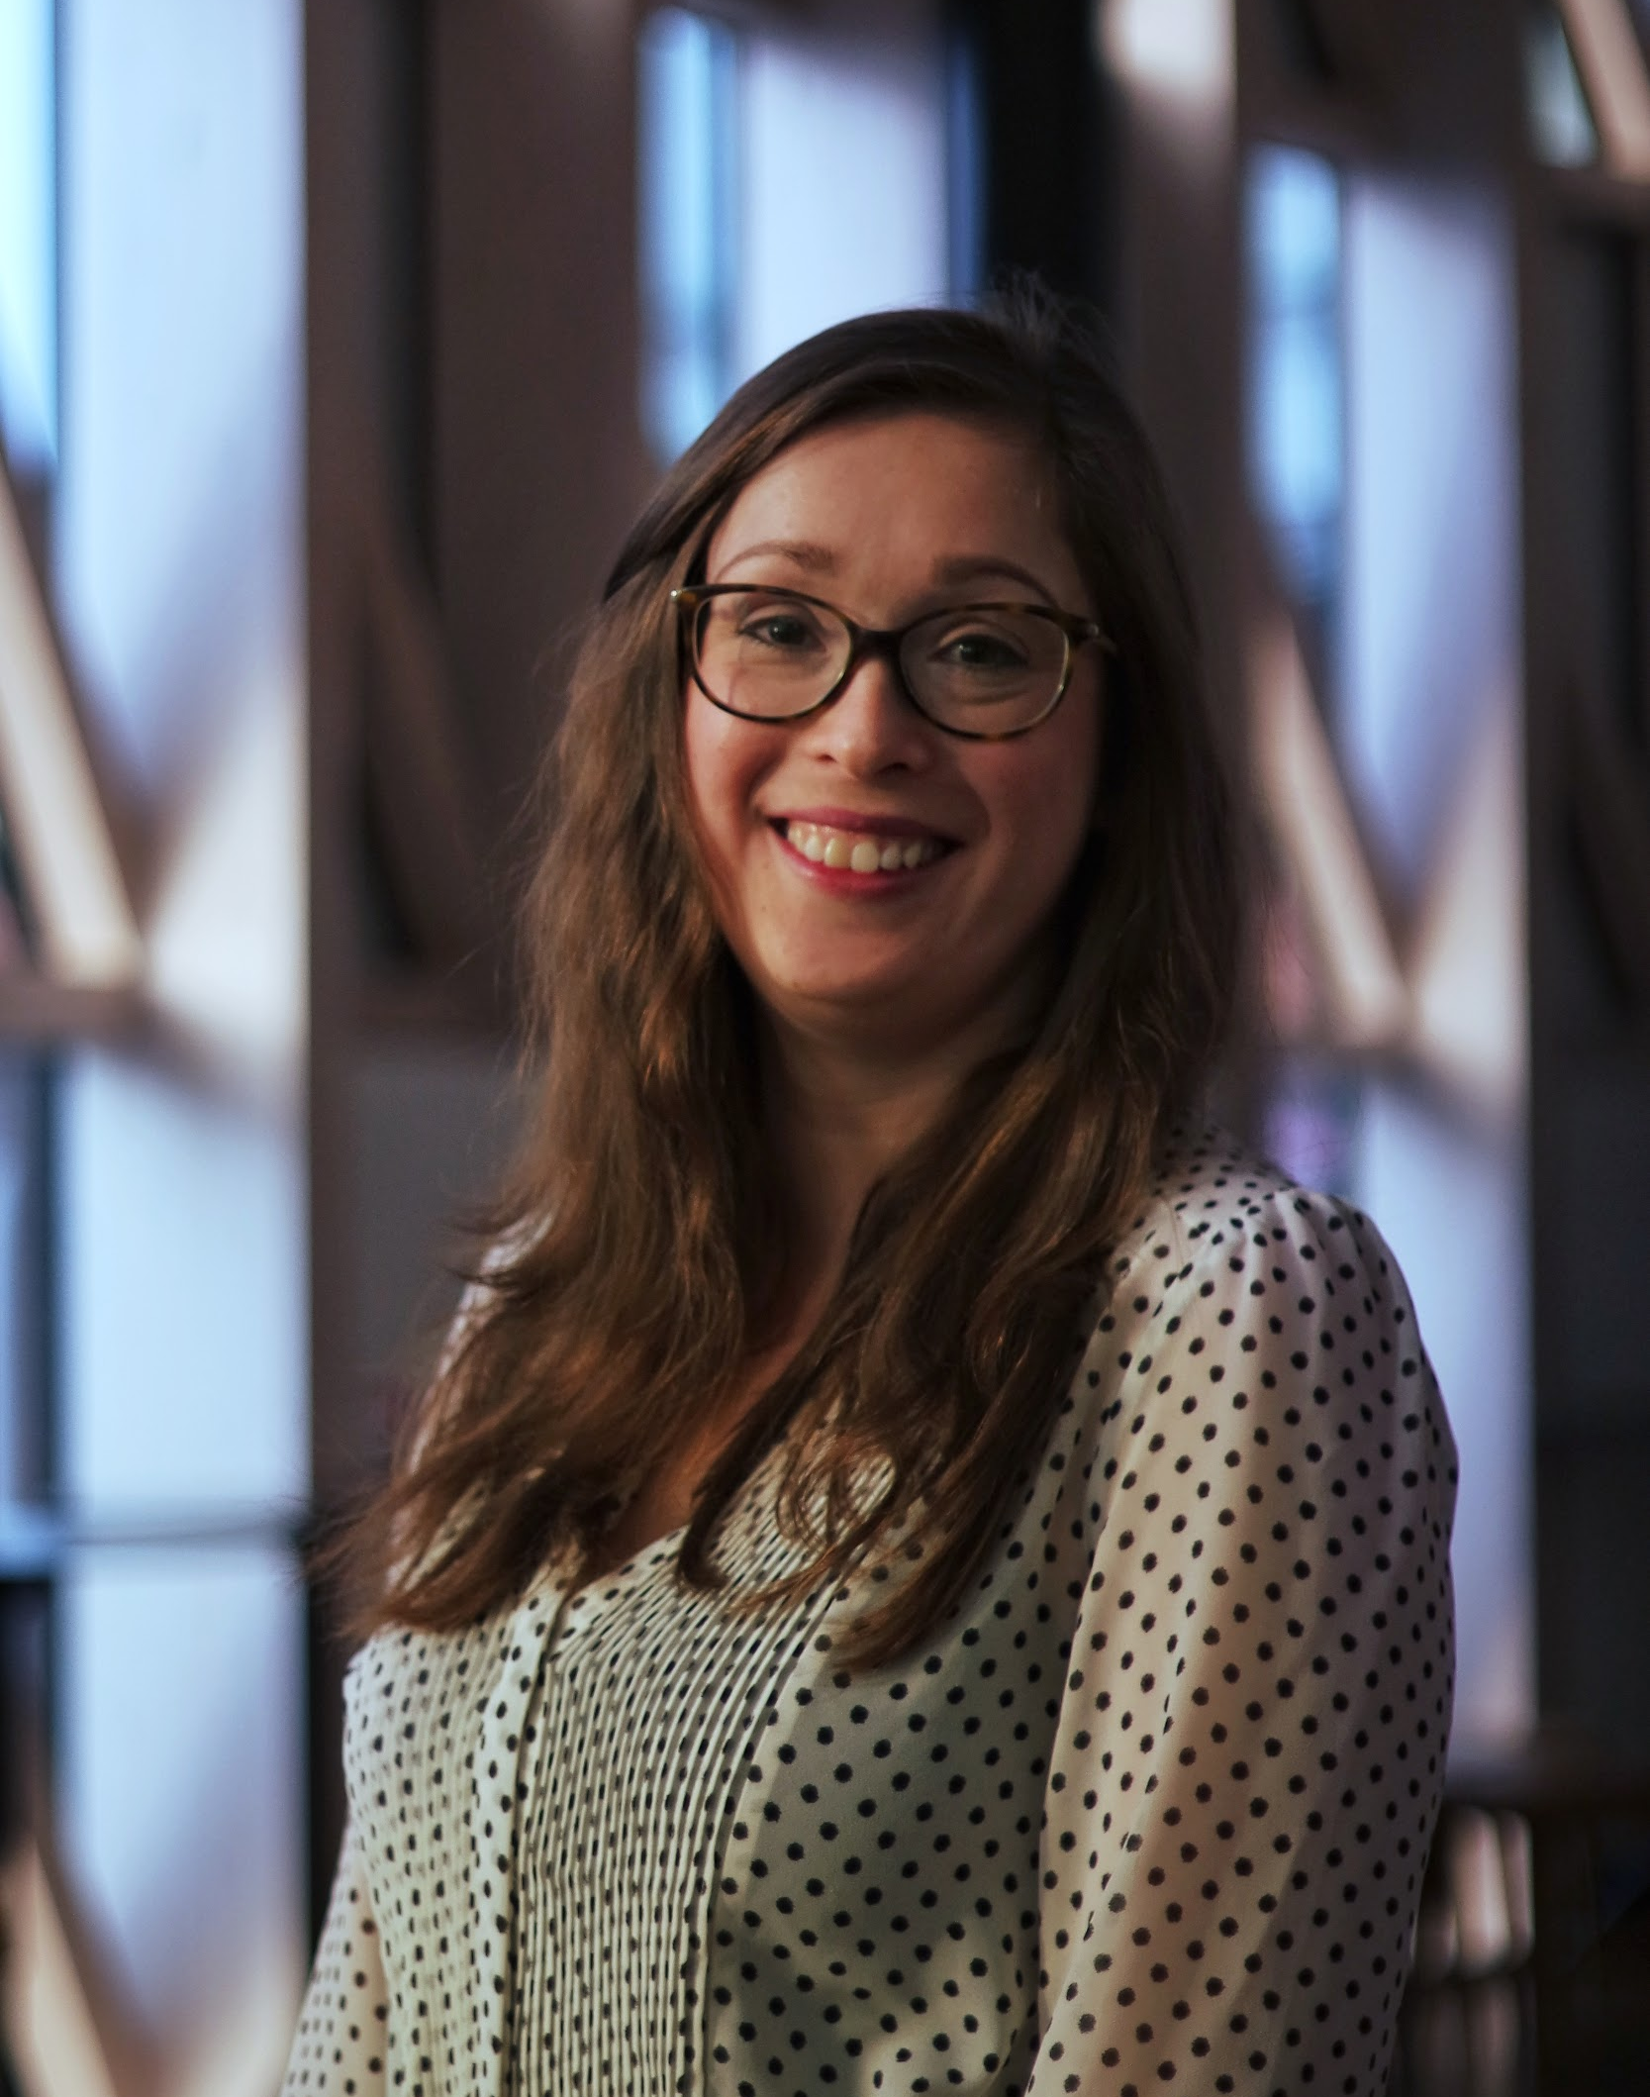
ORGANIZING BOARD
Tiago Marques Pedro
Operations Manager
MSc Toxicology (expected)
BSc in Biomedical Science
-Worked as a research associate at Weill Cornell, New York in the area of toxicology (AhR-related)
-Part of the Biomedical Section (BUS) at KI with the role of BIONK representative, aiding in the facilitation of exchange studies for students
Theresa Mader
Marketing and communications
Physiology and pharmacology PhD candidate
MSc. Molecular Life science
-Member of KI’s student association KICC, organizing different scientific and social events targeted at PhD students and PostDocs

